Slide 1
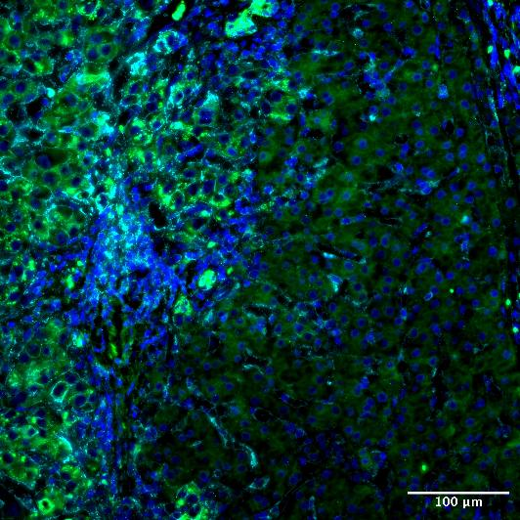
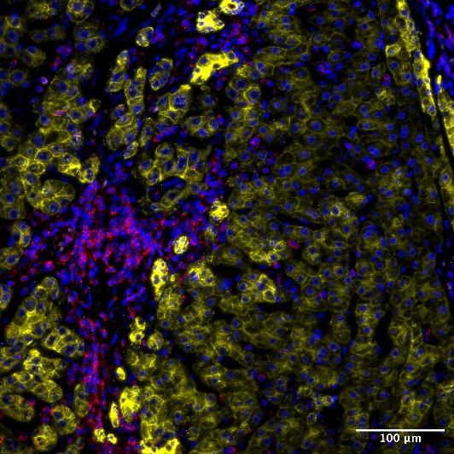
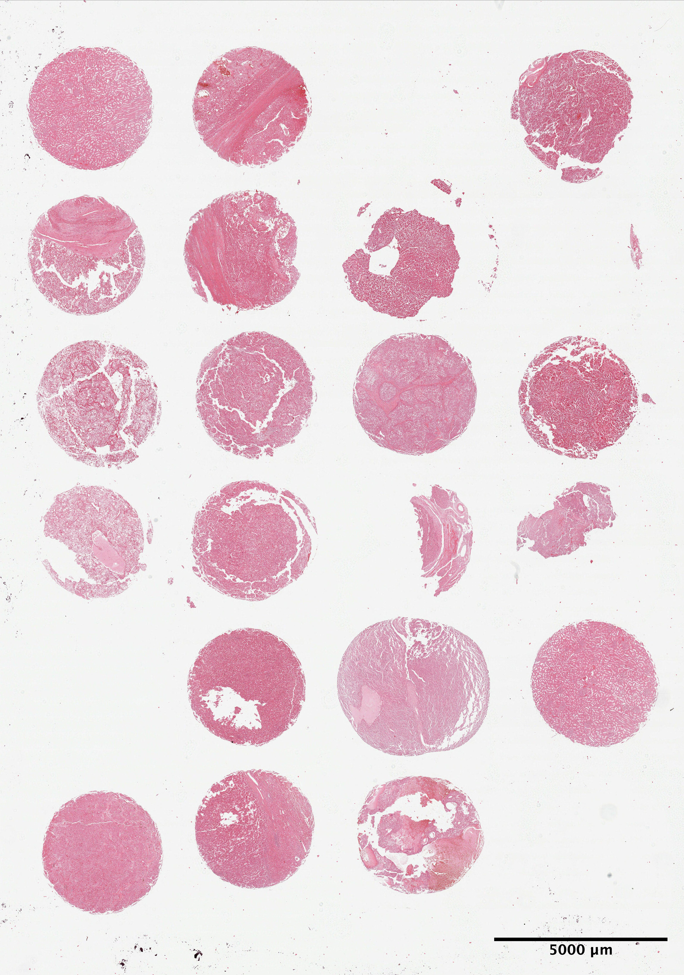
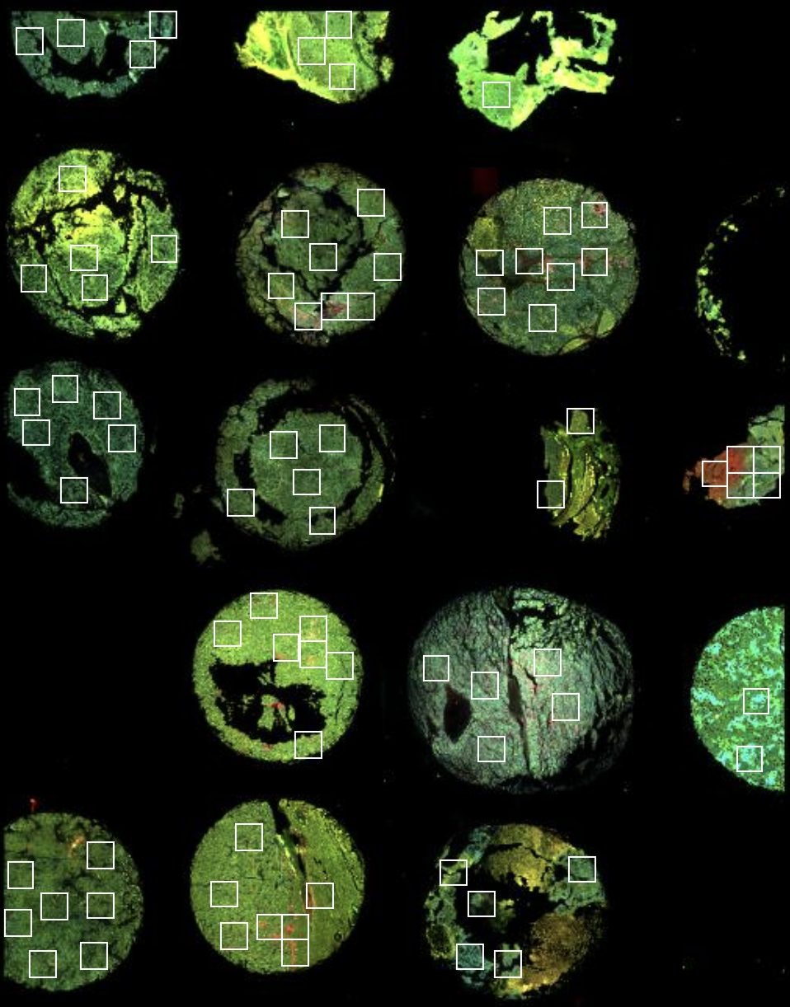
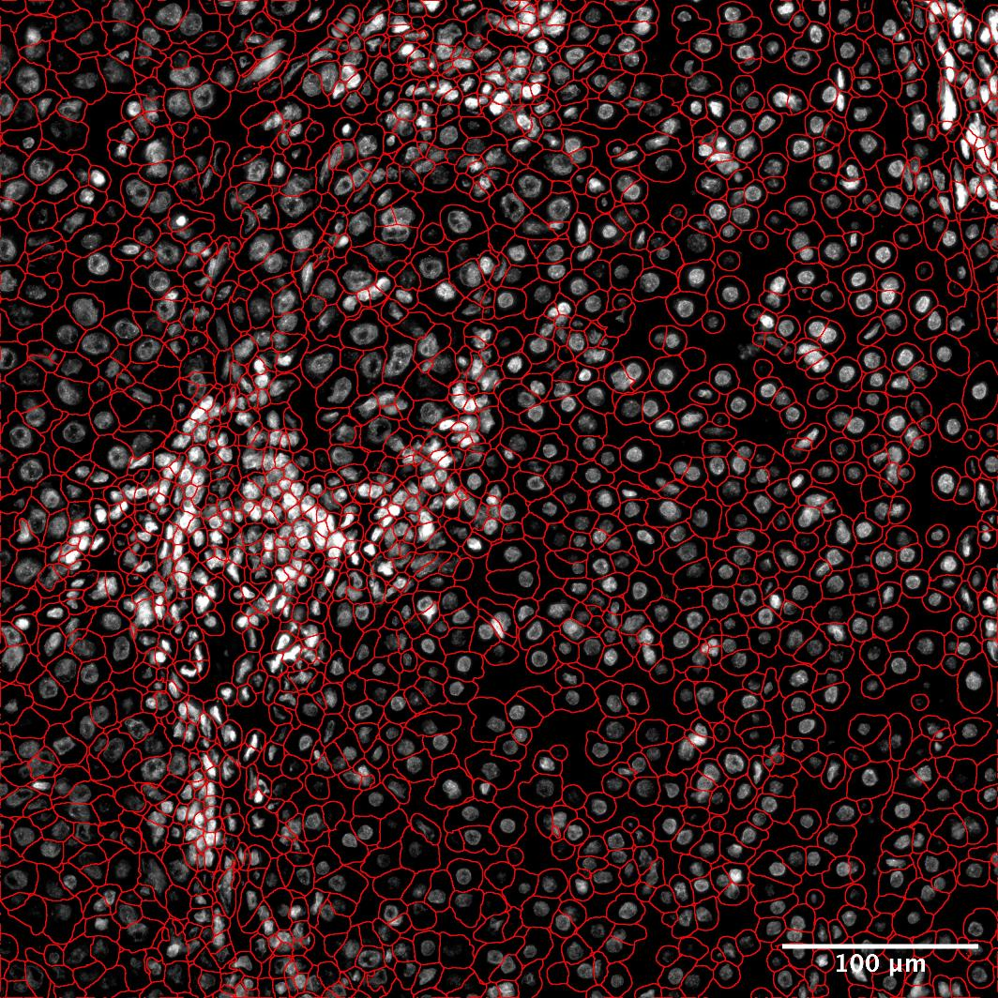
Figure 1
A
C
DAPI
B2M/CD298
PanCK
2 HCC tissue microarrays
n=23 patients
Neighborhood analyses
FOV selection, CosMx SMI
957-plex panel
Custom repeat probes
Validation (RNA-ISH, IHC)
Cell segmentation, data processing, cell-typing
Investigate post surgical clinical outcomes
Differential expression analysis
Gene set enrichment analysis
B
DAPI
CD45
CK8/18
D
DAPI
Cell Segmentation
Tumor genes (GC, TTR, APOC1)
Immune genes (CD4, HLA-DRA, HLA-DRB, CD68, C1QC, SPOCK2, PTGDS, IGKC)
Notes:
Figure 1: Data Overview

Slide 2
Figure 2
A
Clustering & Manual
Annotation
+
InSituType Reference
Mapping
+
Combine with TMA2
Liver & IO reference profiles
B
Spatial mapping
C
D
Notes:
Figure 2: Cell-typing

Slide 3
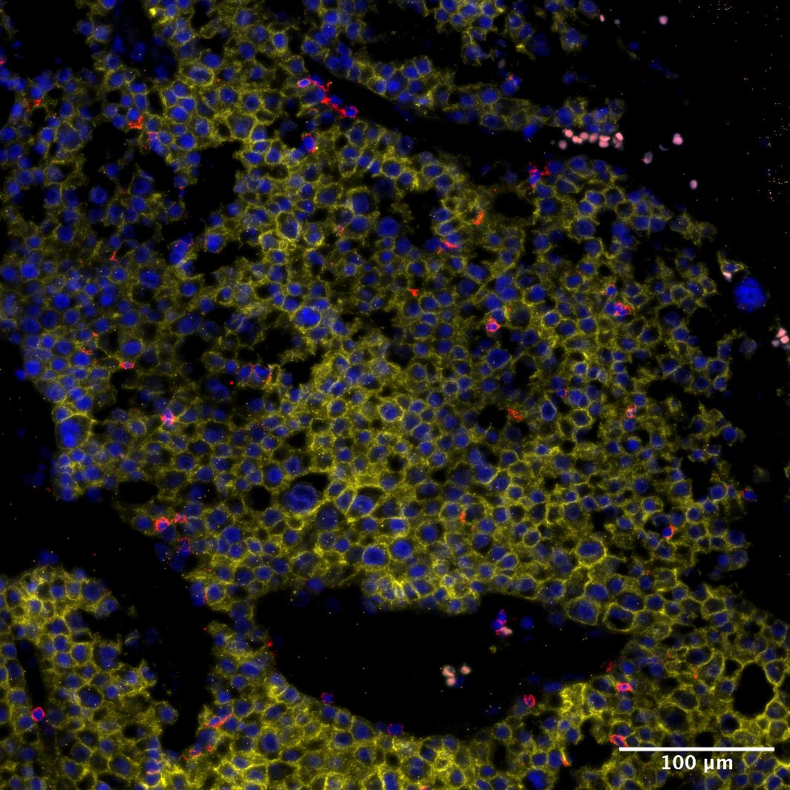
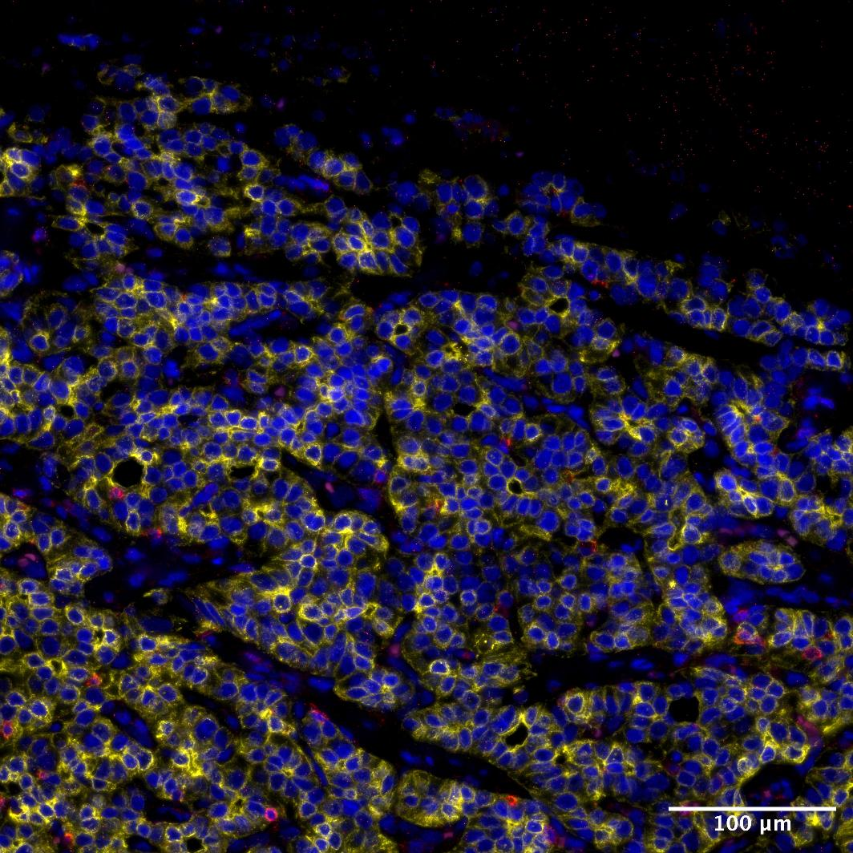
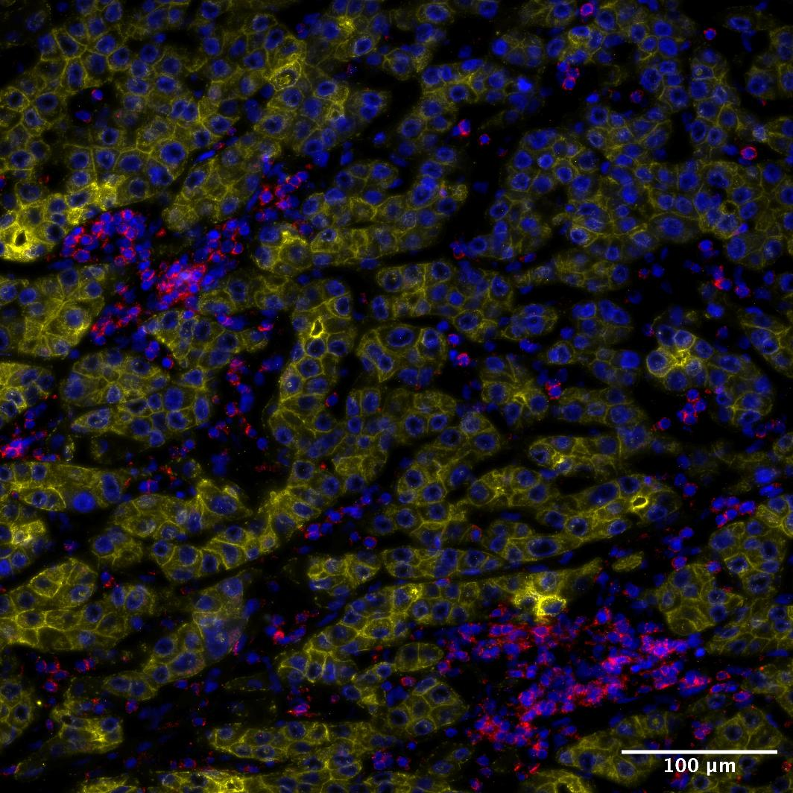
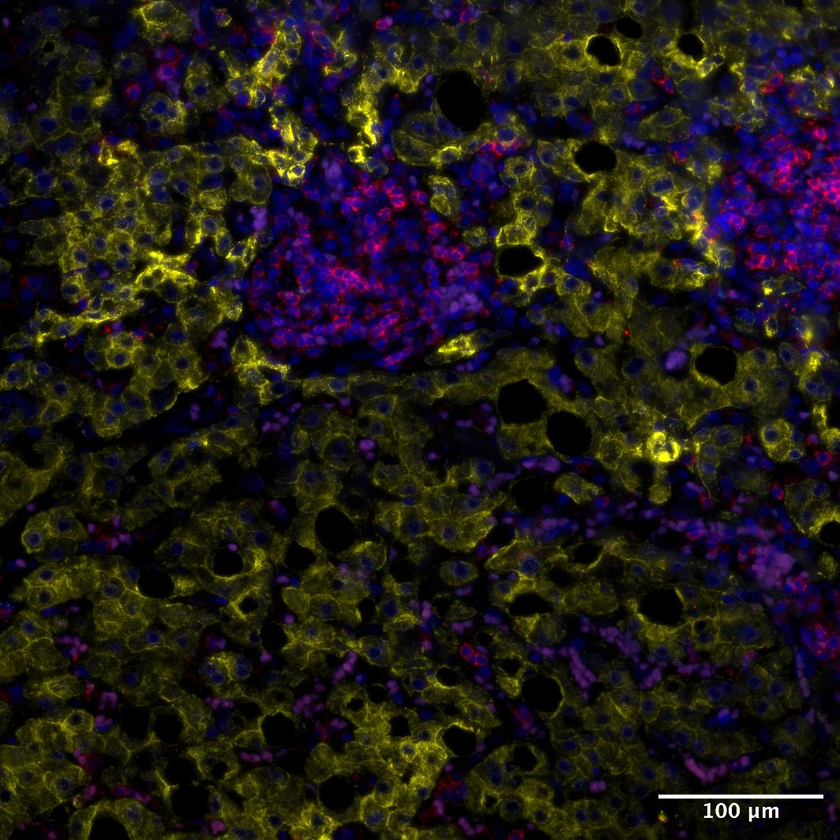
A
B
C
D
E
High
Low
DAPI
CD45
CK8/18
Notes:
Figure 3: Patient-level DE and NE
**DRAFT**

Slide 4
Figure 3
A
B
C
D
F
E
G
Enriched in L1high
Enriched in L1low
Notes:
Figure 3: DE Analysis

Slide 5
Figure 4
A
B
C
D
E
High
Low
DAPI
CD45
CK8/18
Notes:
Figure 4: NE analysis

Slide 6
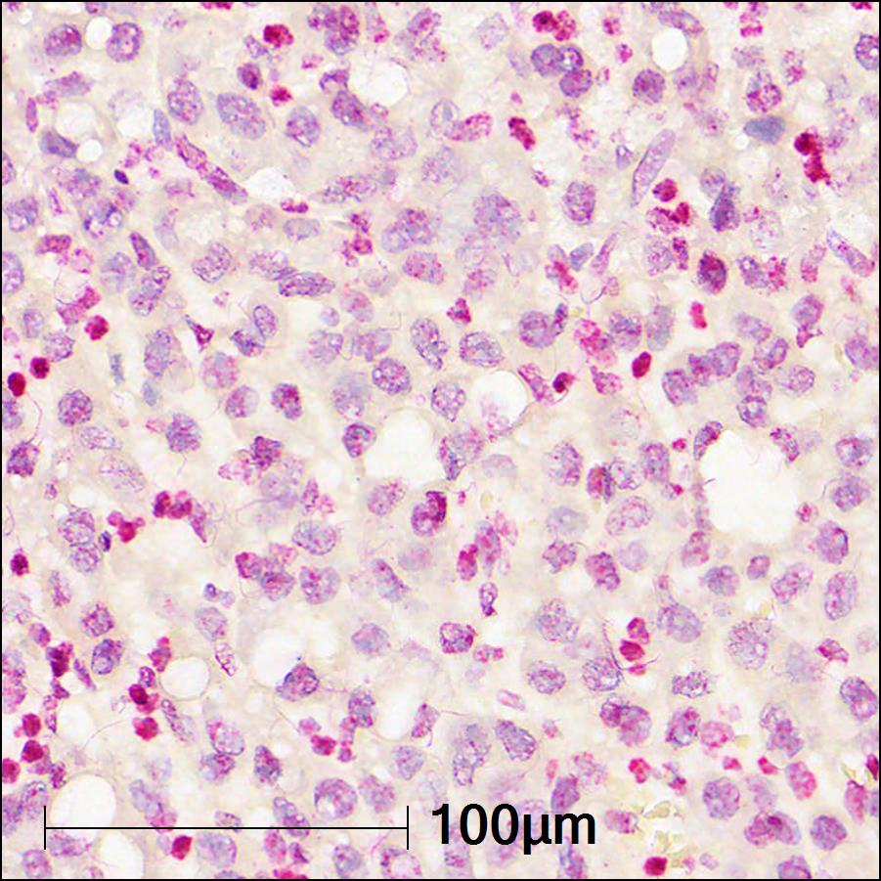
Figure 5
A
Hematoxylin LINE1 RNA-ISH
C
B
D
Notes:
Figure 5: Validation with MIF and ISH

Slide 7
Figure S1
Notes:
Supplementary Figure 1: Spatial Mapping for TMA1

Slide 8
Figure S2
Notes:
Supplementary Figure 2: Spatial Mapping for TMA2

Slide 9
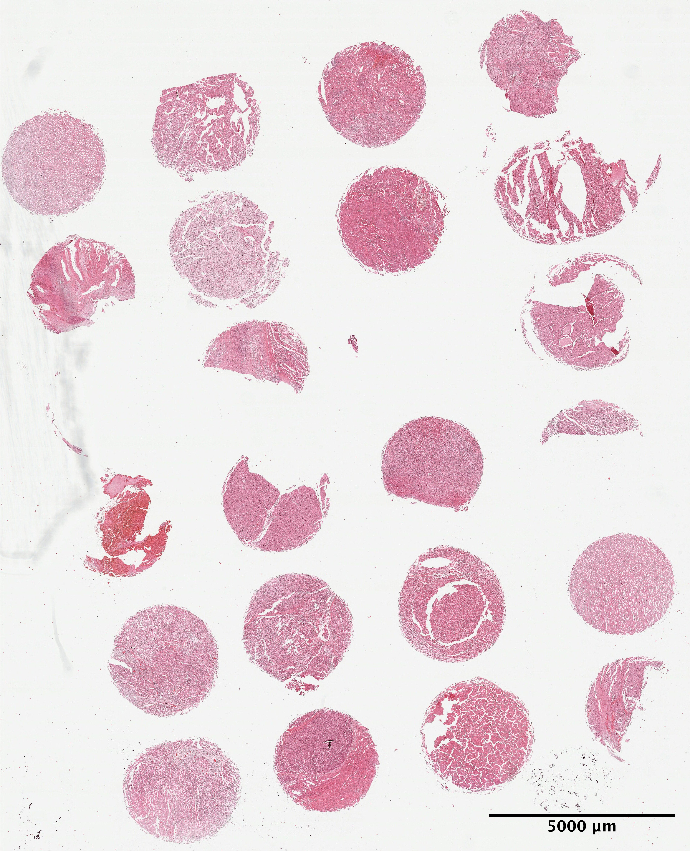
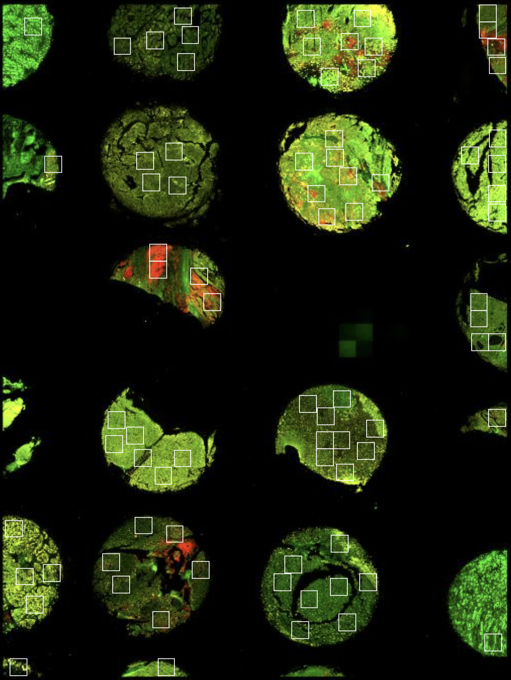
Figure S3
A
B
Core 22
C
E
D
Notes:
Supplementary Figure 3: Overall Maps for TMAs, Tumor UMAP, Stromal UMAP

Slide 10
Figure S4
Notes:
Supplementary Figure 3: Volcano plots identifying marker genes

Slide 11
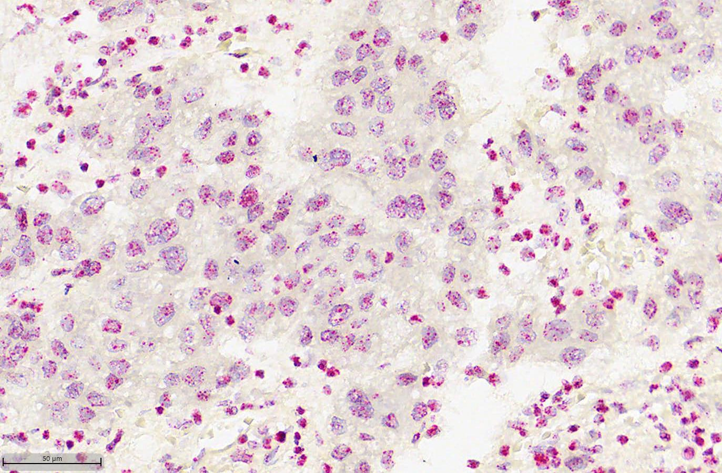
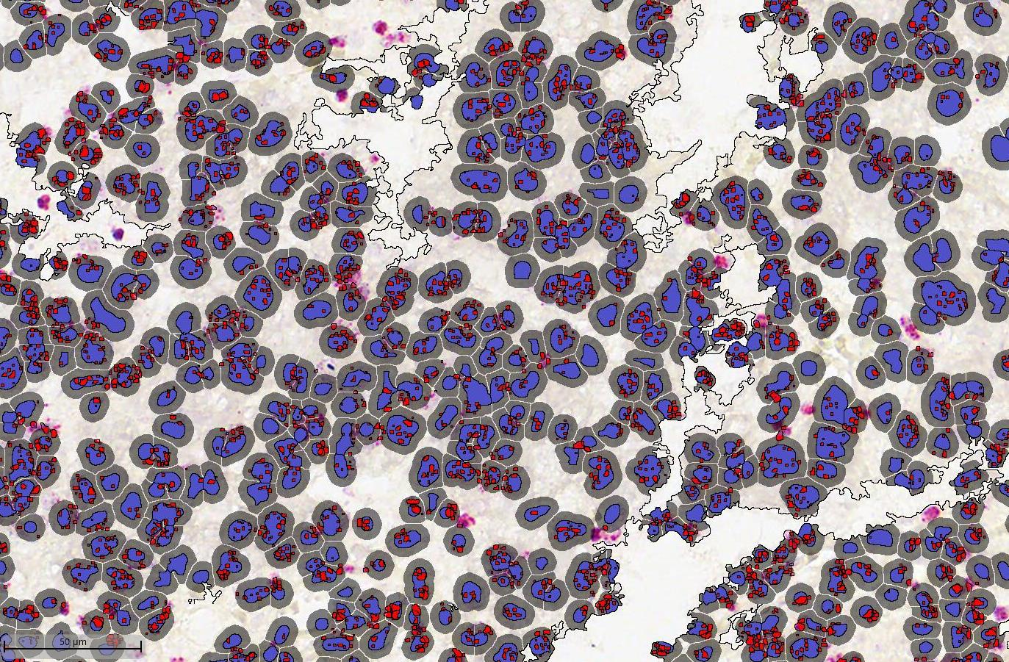
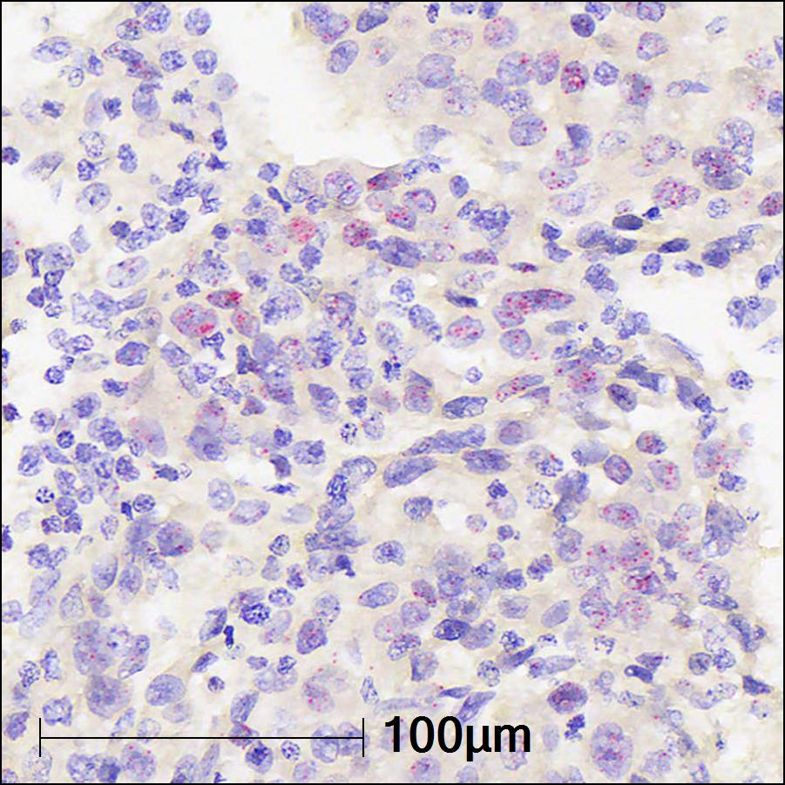
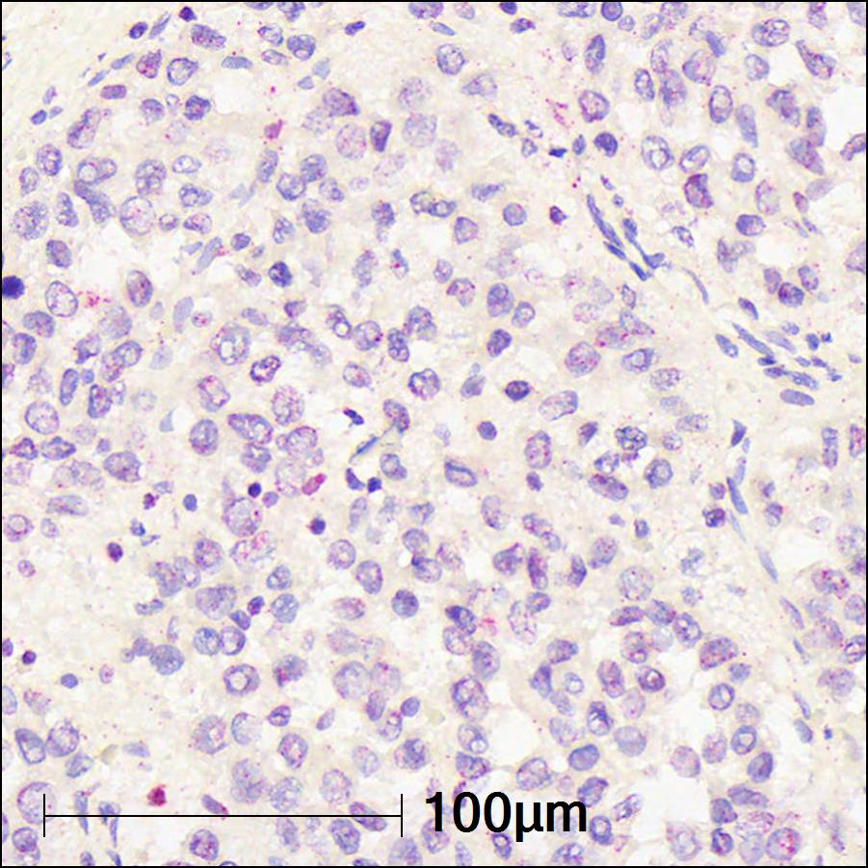
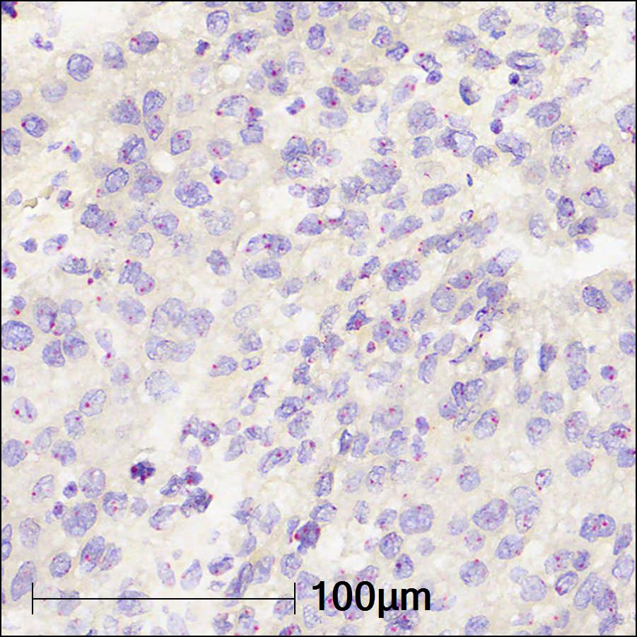
Figure S5
A
B
Scan TMAs after RNA-ISH
50 µm
Segment cells & quantify ISH spots as counts using Indica Labs HALO software
50 µm
C
Hematoxylin HERVK RNA-ISH
Hematoxylin HERVH RNA-ISH
Hematoxylin HSATII RNA-ISH
D
Notes:
Supplementary Figure 5: Extra DE stuff and ISH info

Slide 12
Figure S6
A
B
Notes:
Supplementary Figure 6: Extra NE stuff

